Slide 1

Top global performing films

Slide 2
The data
Most Popular List
Global Top 10
Top 10 by Country

Slide 3
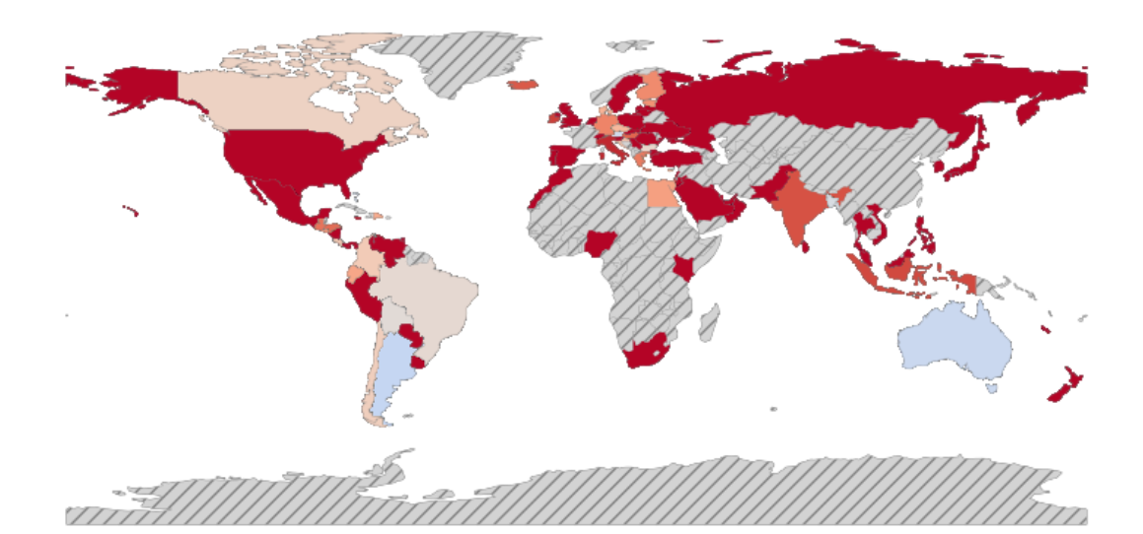
We have 94 countries that we are currently servicing

Slide 4
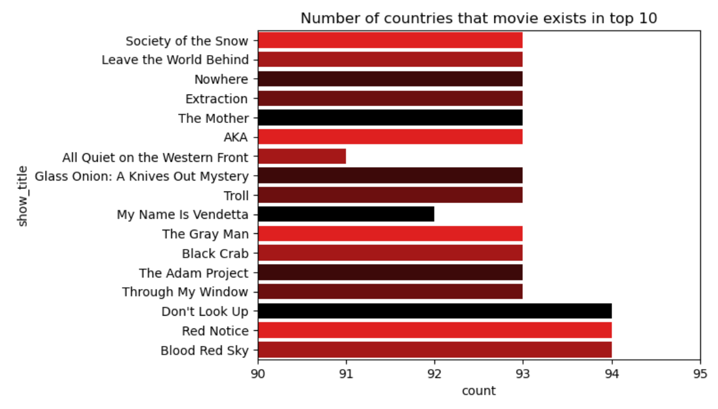
Are all of the countries showing the top movies?
We combined all three datasets to get the movies that were included on all three datasets. This allowed a great preliminary review of the films we were looking at. This left us with data for 17 films. Only three of those films are being aired in all 94 countries.

Slide 5
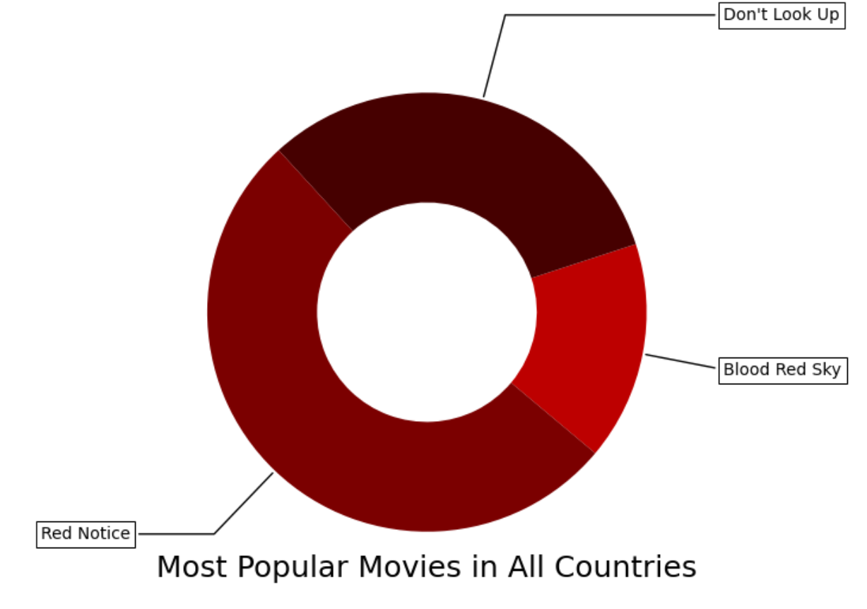
Red Notice is by far the most popular movie with a staggering number of countries and weeks in the top 10, with Don’t Look Up close behind. Blood Red Sky is the most popular non-English movie that is available in all markets.

Slide 6
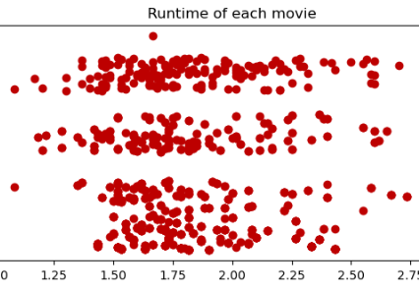
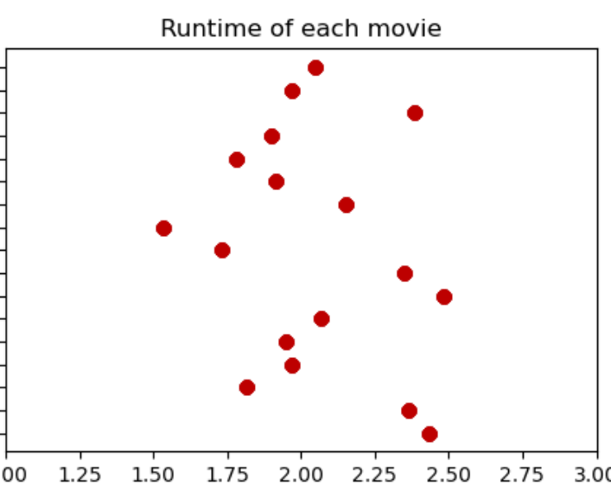
The runtime for all the movies on the global list compared to the top 17 that are on all of the lists is pretty striking on initial review, but they really aren’t that different. Most movies are between 1 hour 45 minutes and 2 hours 30 minutes. There are outlier in the global list because there are more movies in the list.

Slide 7
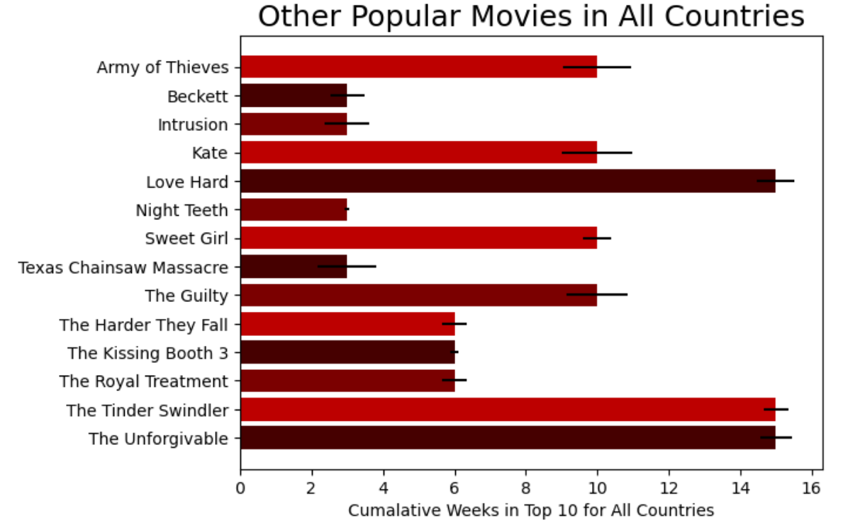
There are quite a few movies in top 10 lists available in all markets, however, were not on the most popular list of movies.

Slide 8

As popular as red notice and blood red sky were, all quiet on the western front averaged more weeks on the global top 10. red notice toped out at 14 weeks, blood red sky at 16 weeks, and all quiet on the western front topped out at 23 weeks on the global top 10 list. It did not make our other top analysis because it was not available in Mauritius or Nigeria

Slide 9

Why do you care about this?
As creative executives and buyers, you can use this information to further evaluate what makes these top movies different, and how can we replicate that when bringing on new productions.

Slide 10

THANK YOU
Sammi Beard
DSC 640 – Weeks 1&2 | Netflix Viewership

